Slide 1
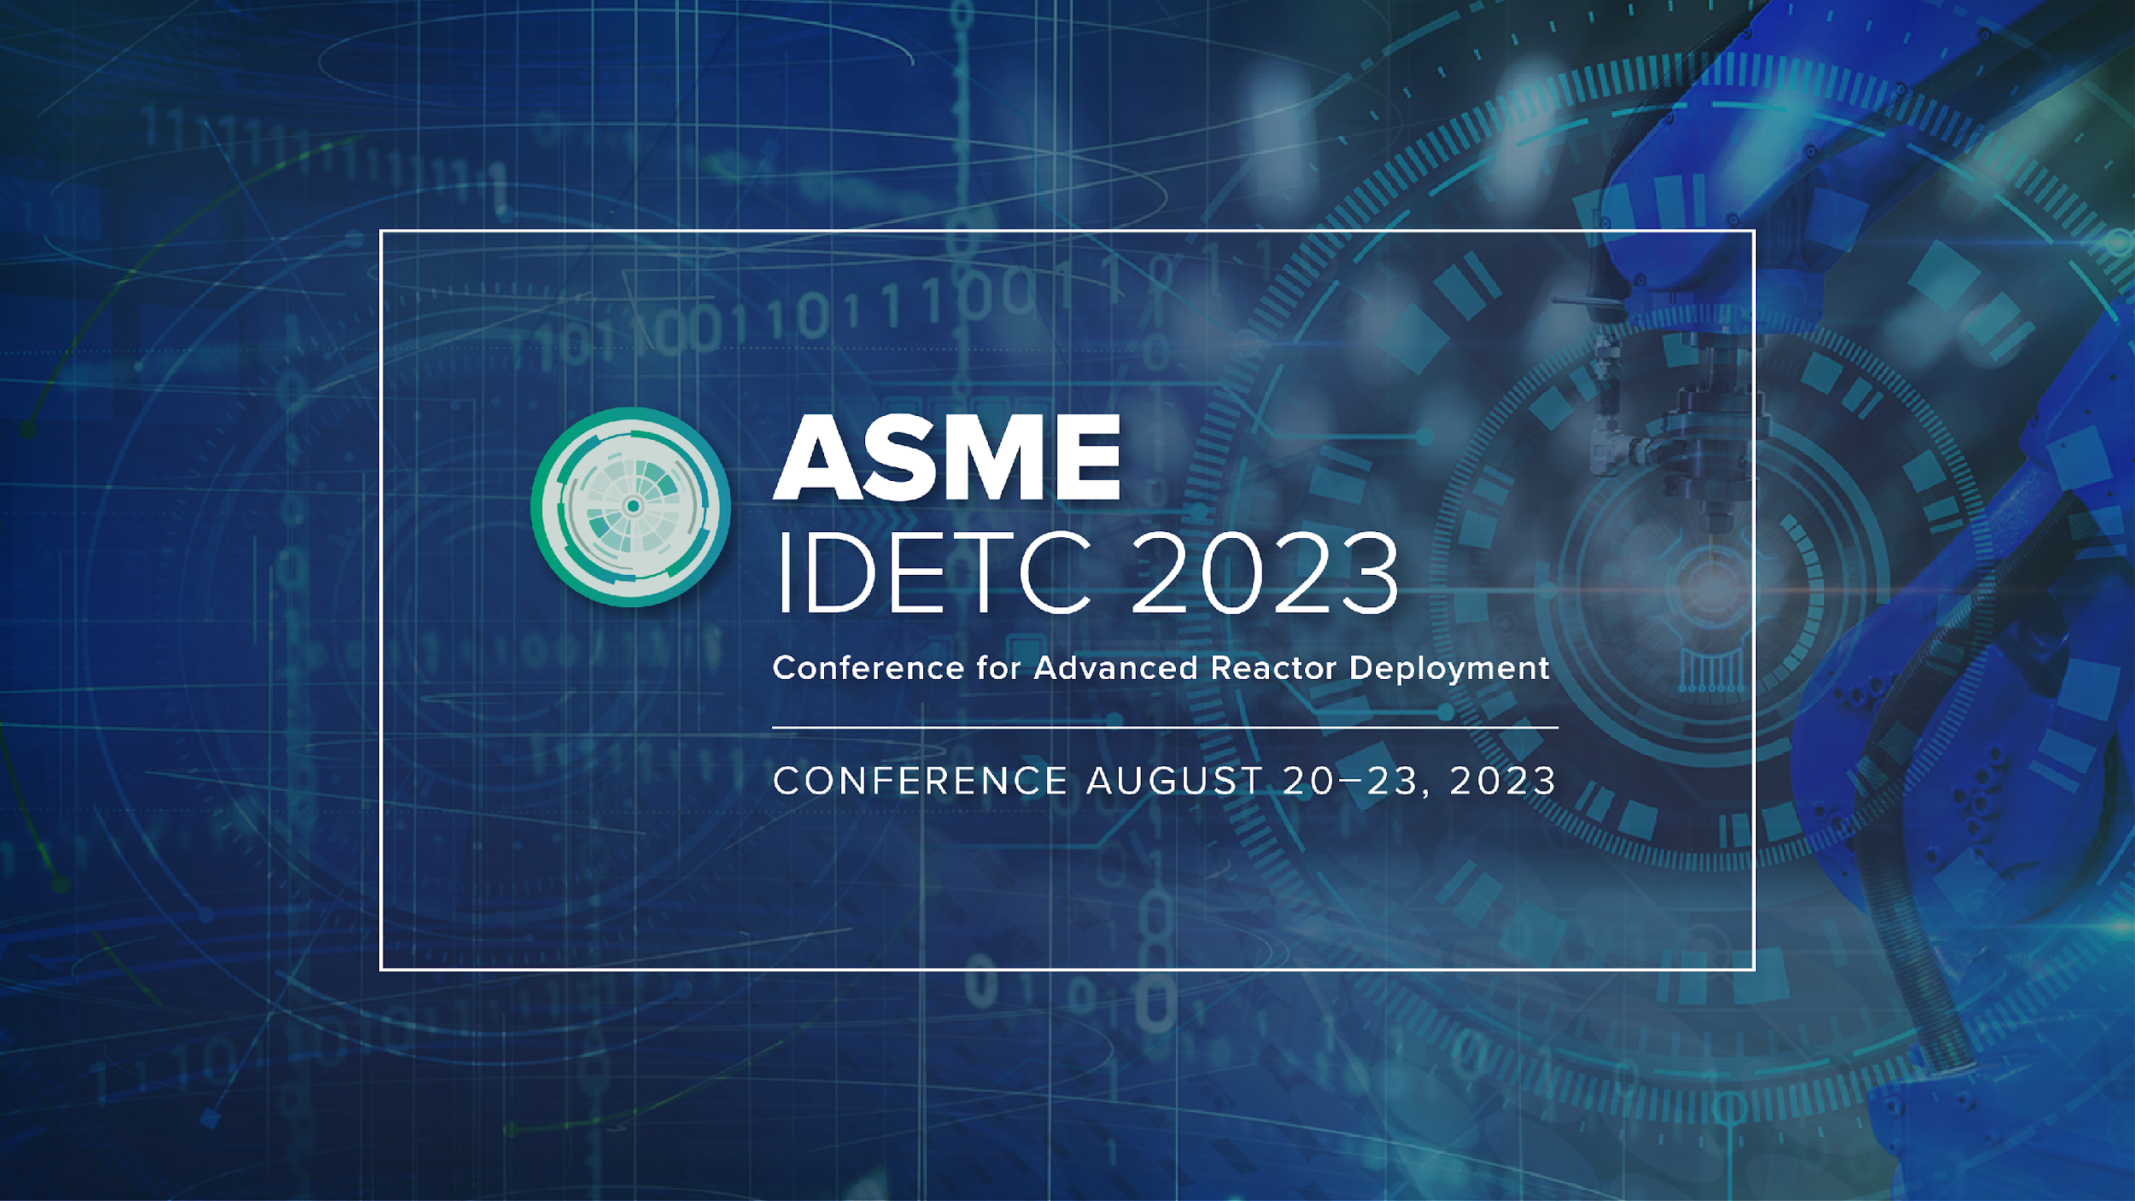

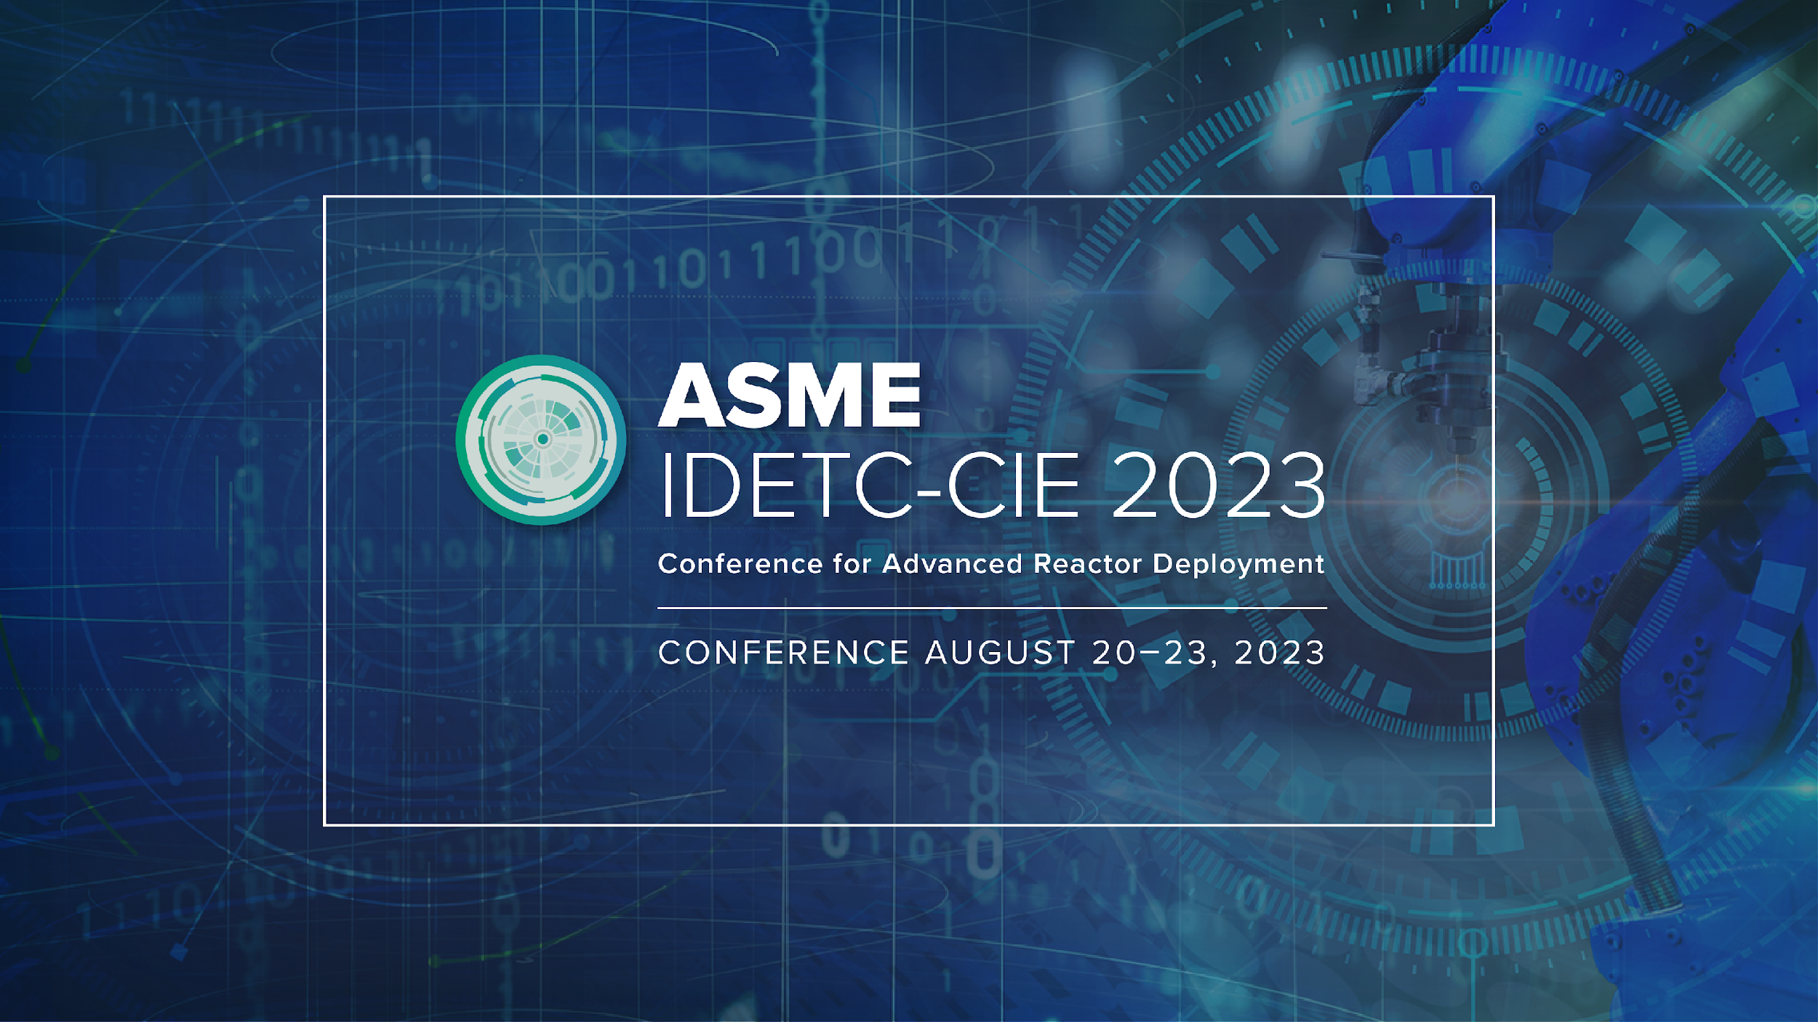

Slide 2

Automating Material Selection for Product Design
Team Aggies
Texas A&M University
Pradeep Bharathi & Marshall Allen
Notes:
Marshall

Slide 3


Introduction
Marshall Allen
PhD Student in Mechanical Engineering
Design Systems Laboratory
PI: Richard Malak
Research focus: Materials Design, Design Methodology, Additive Manufacturing
Pradeep Bharathi
Master of Science Candidate in ME
Design Systems Laboratory
PI: Richard Malak
Research focus: ML methods in Materials Design and applications in FGMs
Notes:
Marshall

Slide 4
Baseline / Reference work
As a starting point, we intended to use the original work by Daniele Grandi [2] as a baseline with
TechNet [4] for semantic name feature embedding
Semantic features include the body name, occurrence name and other technology-focused texts
Multi-View Convolutional Neural Network (MVCNN)
To render the geometric features
a GraphSAGE Graph Neural Network model [3]
As a material prediction ML model
Notes:
Pradeep

Slide 5
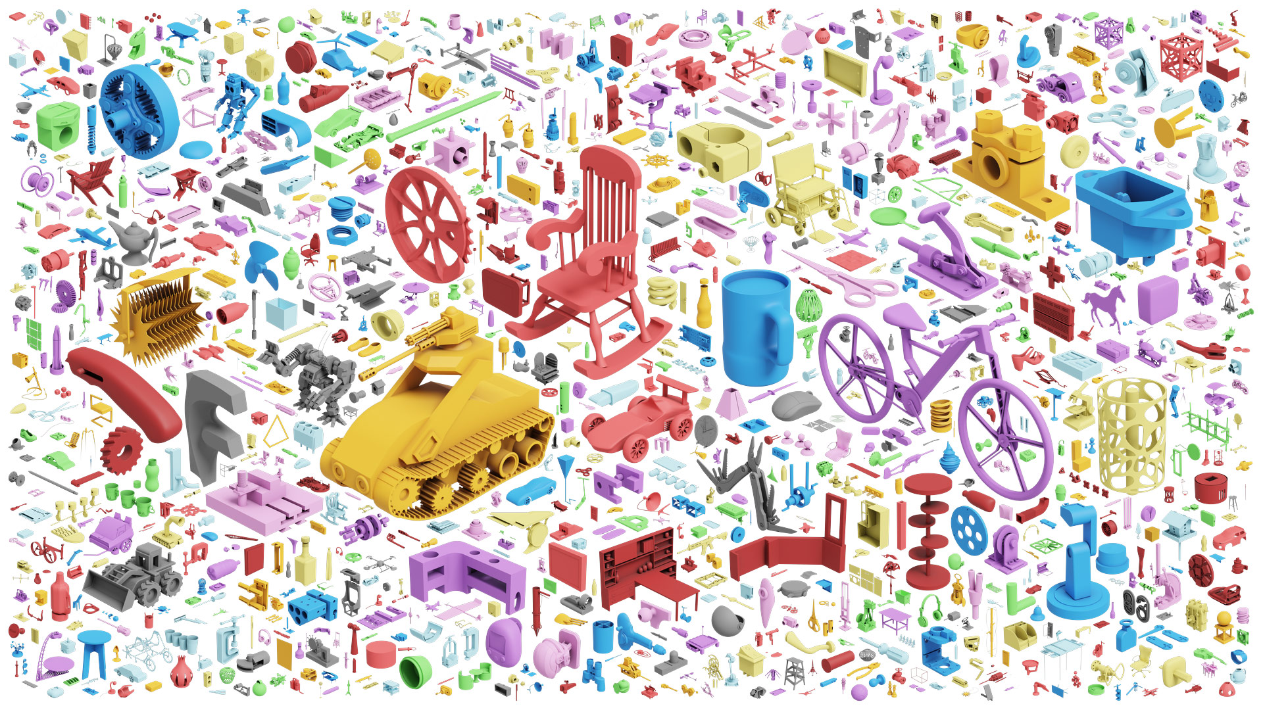
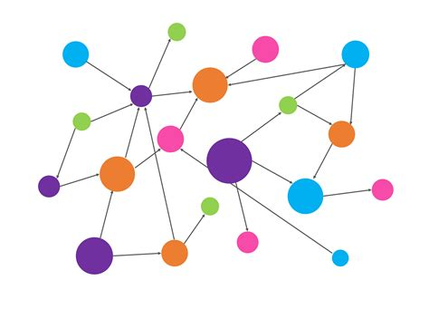
Data Analysis
Assembly Dataset
Due to the perceived importance of part-assembly and part-part adjacency relationships in the data we primarily focused on using a graph representation as the basis of our prediction pipeline
Labeled Property Graph Representation
Relationship context between parts in an assembly is an important feature
Using a labeled property graph (LPG) to represent the data allows us to represent these relationships & leverage novel graph learning techniques
Notes:
Pradeep

Slide 6
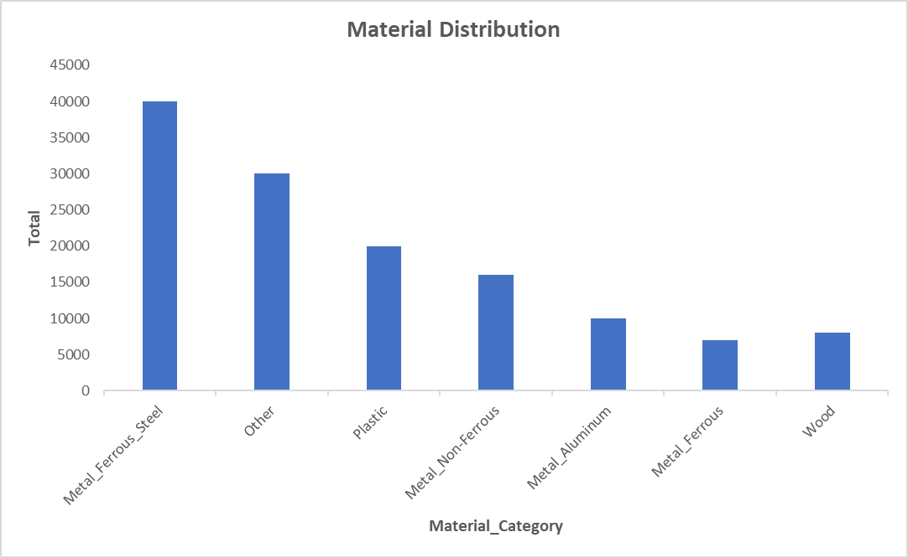
Data Analysis
Assembly Dataset
6336 total assemblies
131,248 total material categories to train on
Plot on the Material Category Distribution is seen below:
Skewed distribution
Notes:
Pradeep

Slide 7
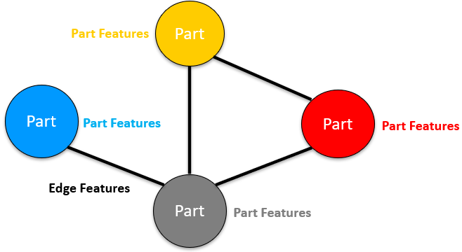
Data Processing
Labeled Property Graph (LPG) structure
Part nodes for each unique body
Edges between parts/bodies in contact
Inherits “contacts” properties & labels
Test/train split of 80/20
# 'train' = 5043
# ‘test’ = 1293
Notes:
Marshall

Slide 8
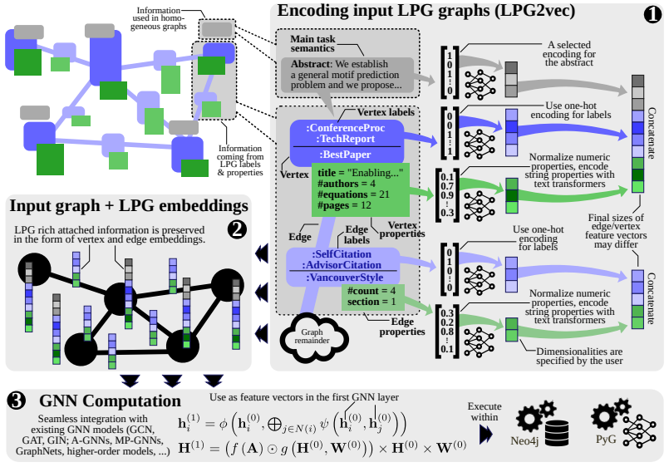
Graph Feature Embedding
LPG2vec [1]
Labels: one-hot encoding
Properties:
Discrete property: normalized one-hot vector
Continuous scalar: normalized
Numerical vector: standardized & normalized
String of text: embedded with sentence-BERT [5] sentence transformers
Results are concatenated into input feature vectors for each node and edge respectively
[1]
Notes:
Marshall

Slide 9
Graph Neural Networks - Node Classification
Task: Classify material “label” of nodes - “what material is this body likely made out of?”
Graph Construction:
Multi-Graphs
Node edges represent the body and edges are their corresponding connections made like joints or contact surfaces
Methods:
Graph Convolutional Network (GCN) [6]
a seminal convolutional GNN model
Graph Attention Network (GAT) [7]
a seminal attentional GNN model
Graph Isomorphism Network (GIN) [8]
a seminal model with more discriminative/representational power
Discriminatory capabilities equal to the Weisfeiler-Lehman (WL) graph isomorphism test[9] a powerful test known to distinguish a broad class of graphs
Baseline:
GraphSAGE [3]
Notes:
Marshall

Slide 10
Lessons Learned & Conclusions
Varied graph methods in literature with different strengths/weaknesses
Work to do with the proposed lpg2vec method
Certain missing features in the testing data like material ID, appearance ID inhibited the baseline implementation
Used the intuition of the proposed method to figure out the material types for each of the 156 body parts in the testing data
Hence there is no evaluation metric to validate the results

Slide 11
Future Research Directions
As mentioned in [2], the semantic names (defined by users) played a significant role in the prediction of the materials (seen from the micro F1-score aka., accuracy score)
This can significantly impact the learning as noticed in the test data provided to us because an user may leave the body names and other technical information in the default way like body1, xyz2, assembly_body23
One way to overcome this can be by means of the lpg2vec feature encoding method
Graph Clustering techniques and its feasibility in this problem
Notes:
Pradeep

Slide 12
References
Besta, Maciej, Patrick Iff, Florian Scheidl, Kazuki Osawa, Nikoli Dryden, Michal Podstawski, Tiancheng Chen, and Torsten Hoefler. 2022. “Neural Graph Databases.” arXiv. http://arxiv.org/abs/2209.09732.
Bian, Shijie, Daniele Grandi, Kaveh Hassani, Elliot Sadler, Bodia Borijin, Axel Fernandes, Andrew Wang, et al. 2022. “Material Prediction for Design Automation Using Graph Representation Learning.” In . American Society of Mechanical Engineers Digital Collection. https://doi.org/10.1115/DETC2022-88049.
Hamilton, William L., Rex Ying, and Jure Leskovec. 2018. “Inductive Representation Learning on Large Graphs.” arXiv. http://arxiv.org/abs/1706.02216.
“TechNet: Technology Semantic Network Based on Patent Data - ScienceDirect.” n.d. Accessed August 20, 2023. https://www.sciencedirect.com/science/article/pii/S0957417419307122.
Reimers, Nils, and Iryna Gurevych. 2019. “Sentence-BERT: Sentence Embeddings Using Siamese BERT-Networks.” arXiv. https://doi.org/10.48550/arXiv.1908.10084.
Kipf, Thomas N., and Max Welling. 2017. “Semi-Supervised Classification with Graph Convolutional Networks.” arXiv. https://doi.org/10.48550/arXiv.1609.02907.
Veličković, Petar, Guillem Cucurull, Arantxa Casanova, Adriana Romero, Pietro Liò, and Yoshua Bengio. 2018. “Graph Attention Networks.” arXiv. http://arxiv.org/abs/1710.10903.
Xu, Keyulu, Weihua Hu, Jure Leskovec, and Stefanie Jegelka. 2019. “How Powerful Are Graph Neural Networks?” arXiv. http://arxiv.org/abs/1810.00826.
Weisfeiler, B Yu, and A A Leman. n.d. “THE REDUCTION OF A GRAPH TO CANONICAL FORM AND THE ALGEBRA WHICH APPEARS THEREIN.”

Slide 13
Thank You
Team Aggies
Texas A&M University
Pradeep Bharathi & Marshall Allen

